Slide 1
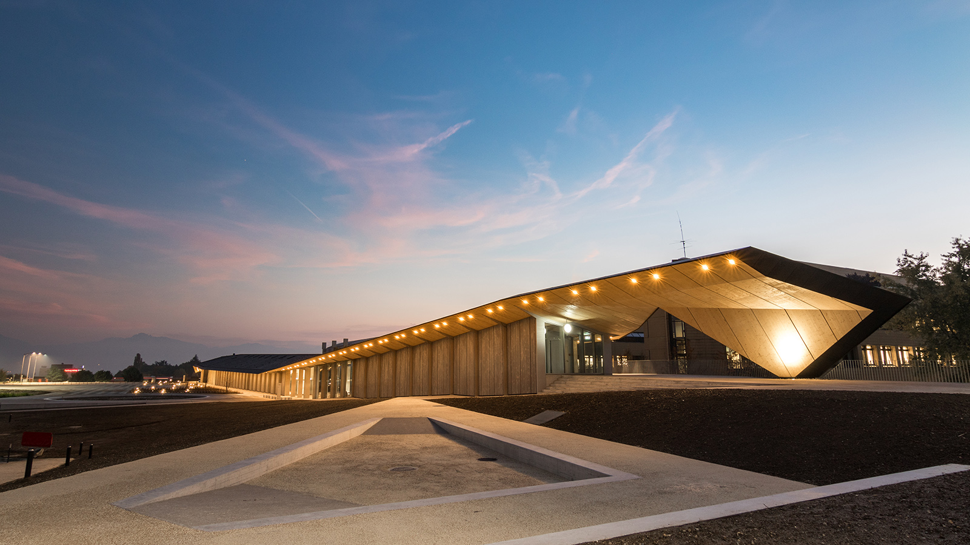

SoftWEAR: Prototyping of a Modular
Hardware Front-End
Semester Project
Author: Neamtu Gabriel
Responsbles: - prof. Dario Floreano - Matteo Macchini -Anand Bhaskaran

Slide 2
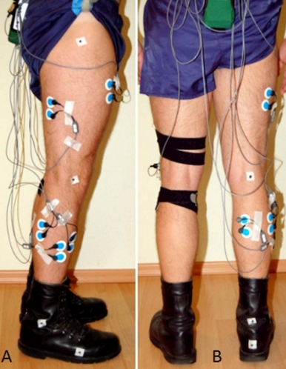
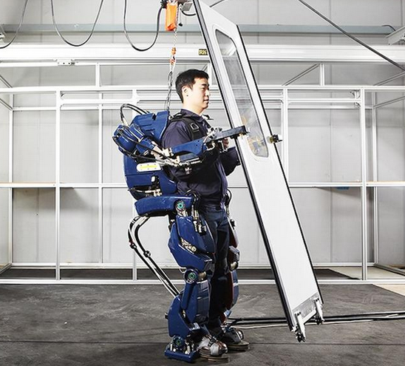
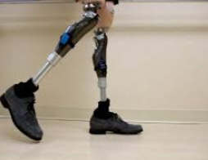
Motivation

Slide 3
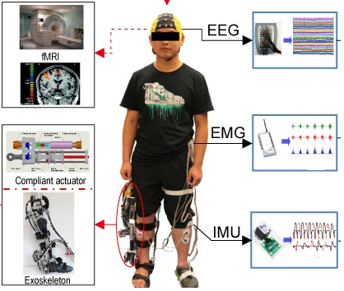
Motivation
Lack of a unified framework
Interfacing of wearable systems takes considerable development time
Different manufacturers have different standards.

Slide 4

Project Goal
Create a hardware + software middleware
Enable future applications using wearable sensors
Support plug-and-play functionality
Hardware recognition features
Modular hardware design

Slide 5
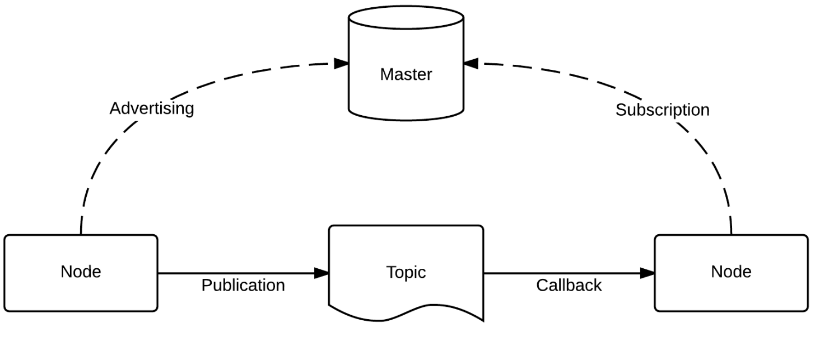
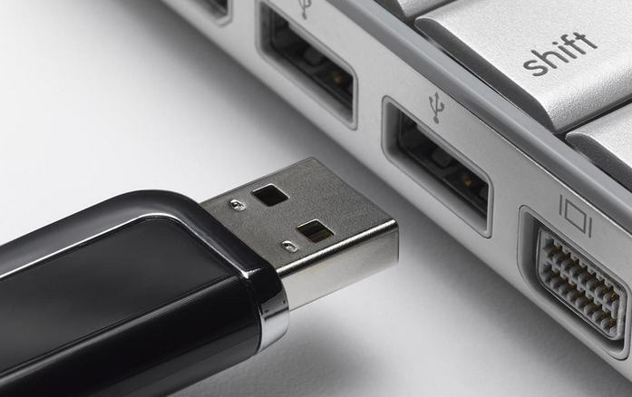
State of the Art
ROS:
+ Node-based architecture with message passing
+ Collection of drivers and libraries
+ Well-known in the robotics world
- Too complex and verbose
Windows USB drivers:
+ Hardware detection defined in USB standard
+ ‘Who are you?’ command defined in USB standard
- Lack of such commands in UART, I2C, SPI

Slide 6
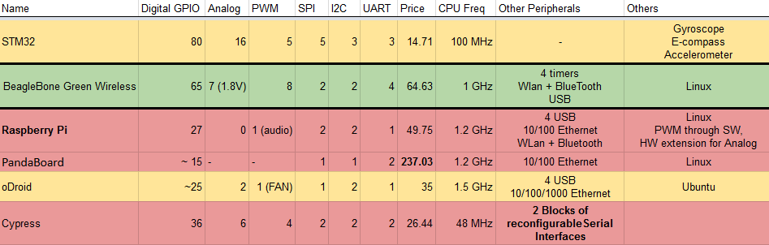
Choosing the hardware
Hard constraints:
Existing development platform
Used in previous LIS projects
OR
Friendly learning curve
Decision criteria:
Peripheral count
Cost
Processing power
Linux

Slide 7
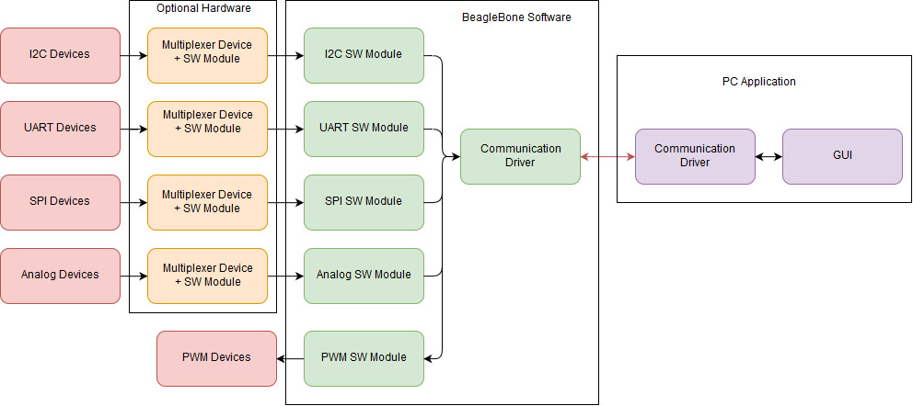
Data Flow and Software Modules

Slide 8
Software Development – Demo Application

Slide 9
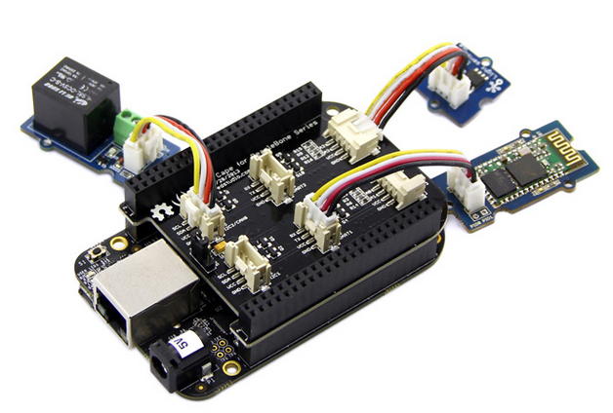
Future Work
A cape for any application:
Same software, modular hardware
Change configuration on-the-fly
Support for even the most peripheral intensive applications

Slide 10

Questions?

